Slide 1
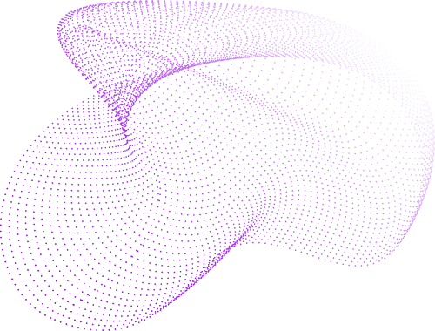
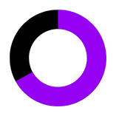
Team Optimizer
MediBot
Diagnosis and Prescription, Simplified !

Slide 2
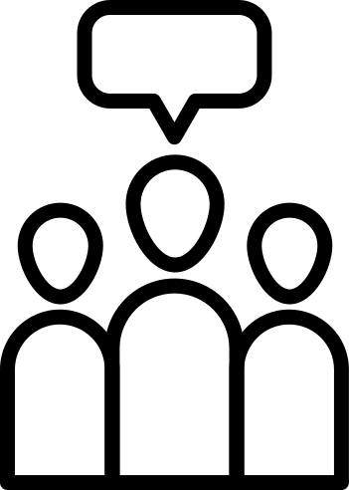
Background
Many patients experience delays and errors in diagnosis and prescription, especially in regions lacking expert medical professionals.
Symptoms can overlap across diseases, making accurate and rapid identification challenging.
Determining proper medications and dosages requires expertise, up-to-date guidelines, and patient-specific factors.
AI advancements in healthcare now allow analysis of symptoms, disease prediction, and personalized treatment recommendations.

Slide 3

Problem Statement
Patients often face delays and errors in disease diagnosis and medication prescription.
Complexity and overlap of symptoms make rapid and accurate identification challenging.
Determining correct medications and dosages requires expertise and patient-specific data.
Goal: Build an AI assistant that predicts diseases from symptoms and recommends safe, guideline-based medications.

Slide 4

Methodology & Approach
Symptom Input: Users provide structured or unstructured symptoms.
Preprocessing: AI cleans and encodes inputs for analysis.
Disease Prediction: AI/ML model identifies the most probable disease(s).
Medication Recommendation: Suggests first-line medications with dosage, route, frequency, and duration.
Safety Checks: Provides precautions, contraindications, and flags uncertain cases for human review.
Feedback Loop: Incorporates user or clinician feedback for continuous improvement.

Slide 5
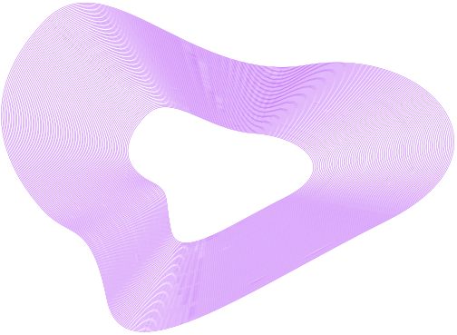

Tech Stack
AI & ML | Data Sources | Backend & Deployment | Frontend / Interface
Python, TensorFlow / PyTorch, scikit-learn Natural Language Processing for symptom analysis | Medical guidelines Symptom-disease databases | FastAPI / Flask for API Cloud deployment (Render) | Web or mobile application Simple and user-friendly UI
BACK TO AGENDA PAGE

Slide 6
Results & Future Scope
Results / Expected Outcomes:
Faster and more accurate disease diagnosis.
Reduced errors in medication prescription.
Improved accessibility to medical guidance, especially in regions with limited healthcare professionals.
Enhanced patient satisfaction and confidence in treatment.
Future Scope:
Integration with Electronic Health Records (EHR) for seamless patient data access.
Support for multimodal inputs like lab results or medical images.
Personalized dosing using patient-specific parameters (age, weight, allergies).
Continuous improvement via feedback-driven AI learning.

Slide 7
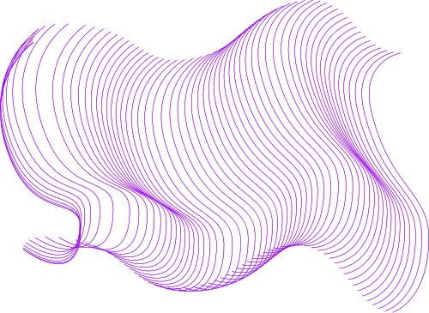

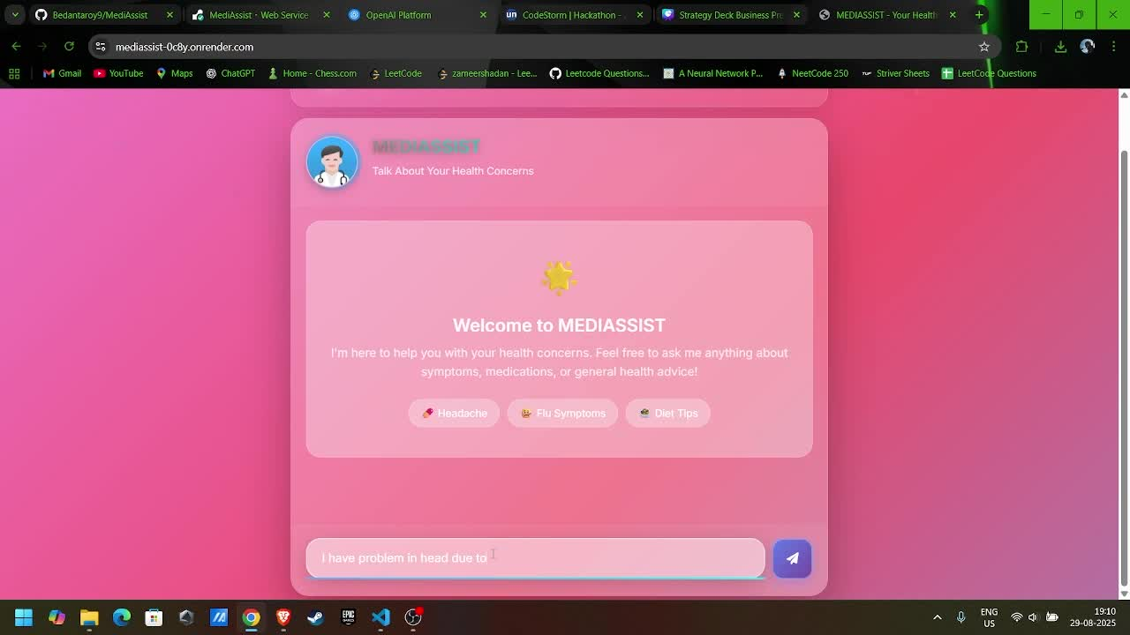
Demo
Github Link : https://github.com/Bedantaroy9/MediAssist
Live Link : https://mediassist-0c8y.onrender.com
⚠️ Note: The app is hosted on Render. If it has been inactive for a while, it may take 30–60 seconds to wake up when you first
open it. Please wait patiently while the service starts.

Slide 8
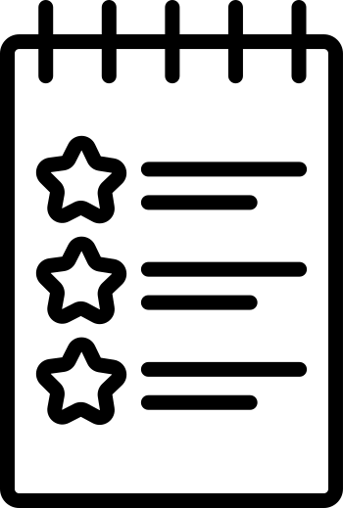
Conclusion
Medibot provides fast, accurate, and safe disease diagnosis and medication guidance.
It reduces errors, improves patient care, and increases accessibility to medical support.
Emphasizes patient safety, regulatory compliance, and explainable AI predictions.
AI as a trusted assistant, not a replacement for doctors.
Future-ready: can integrate EHR, multimodal data, and personalized dosing.

